Slide 1

AI-Assisted Lead Qualification & Automated Follow-Up System
Theme: Industry, Innovation, and Infrastructure
Category: Software (Applied AI / Sales Automation)
Group Number: 04
Group Members: Kunal Redij, Soham Shelatkar,
Makarand Panchal, Varun Panchal
Guide: Prof.Rashmi Dhake

Slide 2
Introduction:
In today’s digital landscape, businesses generate a large volume of inbound leads through websites and online channels, making efficient lead management crucial for improving response time, conversion rates, and overall sales performance. With the growing adoption of AI-driven automation, organizations are increasingly exploring intelligent systems to streamline lead handling and enhance decision-making processes.

Slide 3

Sustainable Development Goal:
This project contributes to SDG 9 – Industry, Innovation & Infrastructure by:
• Promoting AI adoption in small and medium businesses • Reducing operational inefficiencies in sales workflows • Encouraging digital automation infrastructure • Supporting scalable and intelligent communication systems

Slide 4
Literature Survey:
Sr. No. |  | Paper Title | Key Contribution | Relevance to Project
1 |  | Smart Reply – Google | End-to-end neural model for generating short, context-aware email replies | Supports automated, intelligent follow-up generation
2 |  | Characterizing & Predicting Email Reply Behavior | Predicts reply likelihood using message and behavioral features | Helps prioritize high-engagement leads
3 |  | Automating Lead Scoring with Machine Learning | Applies supervised ML models for accurate lead scoring | Foundation for AI-based lead qualification system
4 |  | Mercure: Automatic E-mail Follow-up System | Combines classification and reasoning for automated responses | Ensures structured and reliable follow-up automation
5 |  | Intent-Matching Customer Service Chatbot | Uses NLU for intent detection and response selection | Enables intent-driven scoring and contextual messaging
Year
2025
2024
2023
2022
2022

Slide 5
Problem Statement and Objectives:
Businesses face inefficiencies in handling inbound leads due to manual workflows, slow response times, and poor tracking mechanisms.
Existing systems either depend heavily on manual intervention or implement AI without sufficient safeguards.
This creates the need for a controlled, AI-assisted backend system that automates lead qualification, lifecycle management, and intelligent follow-up generation.

Slide 6
Objectives:
To design an AI-powered backend system that automatically analyzes and qualifies inbound leads.
To implement intent-driven lead scoring using Natural Language Understanding (NLU) for accurate prioritization.
To reduce response latency through adaptive, context-aware automated follow-ups.
To establish a structured, state-aware lead lifecycle management system for efficient tracking and engagement.

Slide 7
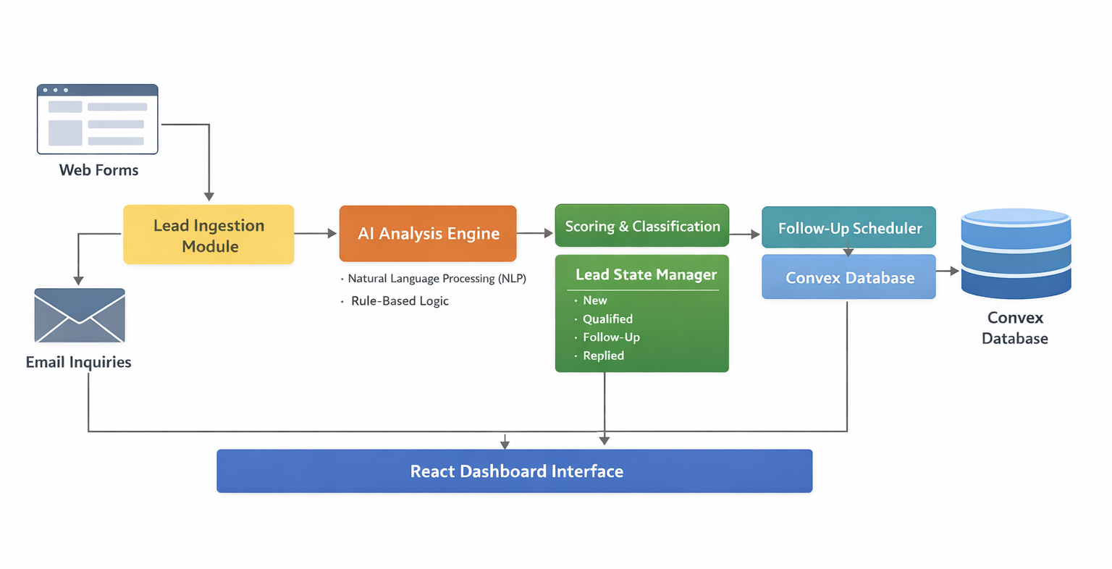
Proposed Structure:

Slide 8
Methodology:
Collect inbound leads from web forms and emails through the Lead Ingestion Module.
Analyze lead content using NLP and rule-based logic to extract intent and key signals.
Score and classify leads, then assign structured lifecycle states (New → Qualified → Follow-Up → Replied).
Generate adaptive follow-ups and store all data in the database for monitoring via the dashboard.

Slide 9
Experimental Setup:
Backend: FastAPI (Python)
Frontend: React
Database: Convex
Authentication: Clerk

Slide 10
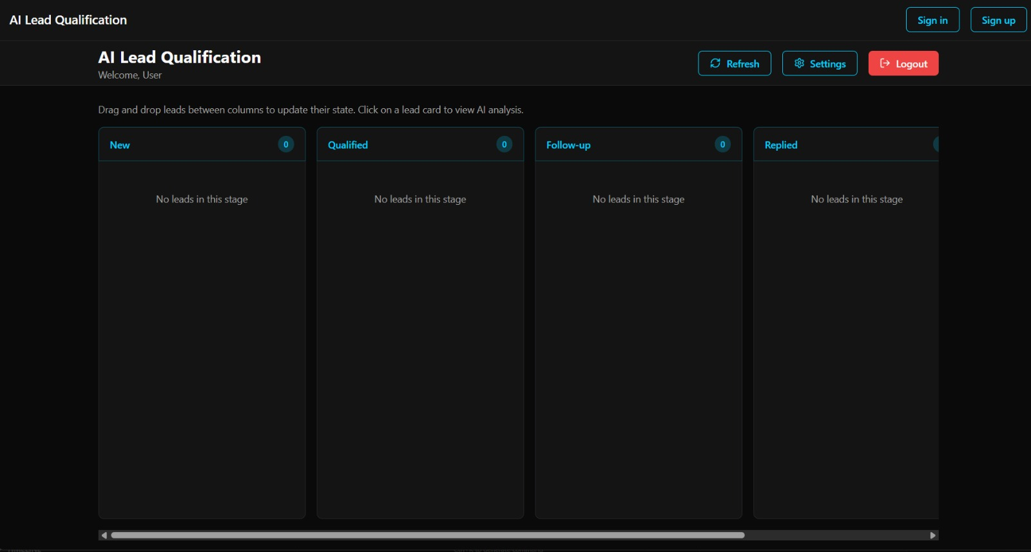
Implementation:

Slide 11
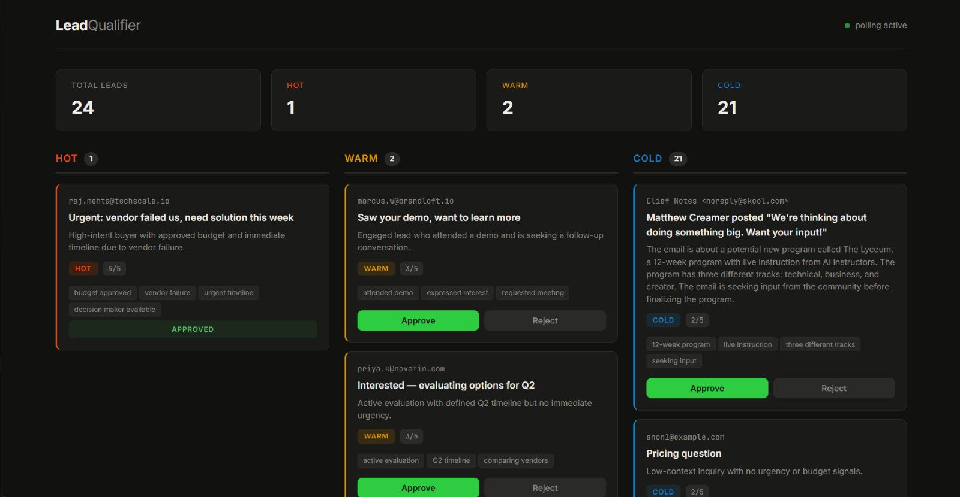

Slide 12
Conclusion:
The AI-Assisted Lead Qualification System:
• Reduces manual effort in screening leads • Eliminates response latency • Improves decision clarity • Introduces explainable AI-based scoring • Maintains structured lifecycle management
Overall, the system provides a scalable and intelligent sales automation solution.

Slide 13
Future Scope:
• CRM system integration • WhatsApp / SMS automation • Reinforcement learning-based scoring refinement • Real-time analytics dashboard • AI confidence scoring improvements

Slide 14
Research & References:
• Automatic Lead Qualification using Opinion Mining (2025) • AI-Driven Sales Automation (2025) • Optimizing Sales Automation Workflows with AI (2025)

